Slide 1
Predictive Maintenance
for
Industrial Equipment
Using Machine Learning for Proactive Maintenance
Team:
Hruthika Sriperumbudur
Srihith Siriga
Rithika Argulawaru

Slide 2
Overview
Industrial equipment is subject to wear and tear, which can lead to unexpected failures and costly downtime.
Traditional maintenance strategies, such as reactive or scheduled maintenance, often fail to optimize the balance between maintenance costs and operational efficiency.
Predictive maintenance offers a data-driven approach to forecast equipment failures before they occur, allowing for proactive maintenance planning.

Slide 3
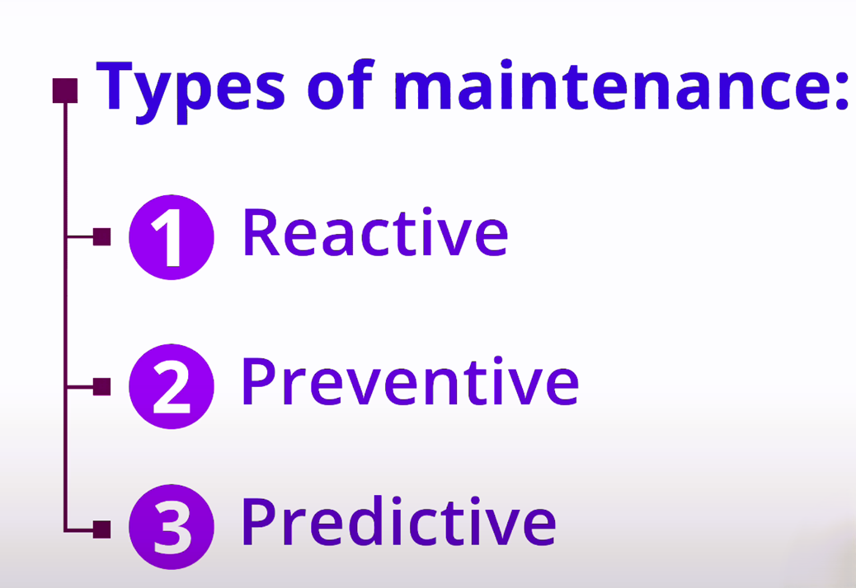

Slide 4
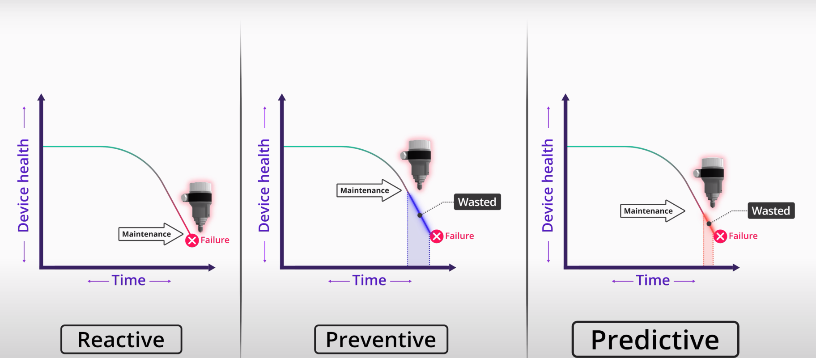

Slide 5
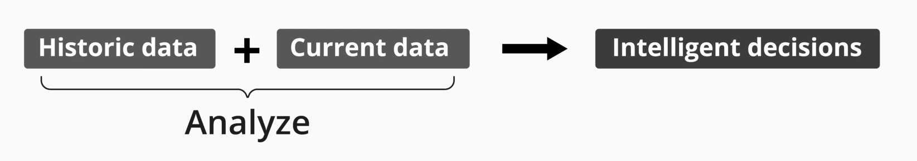
This project focuses on implementing a machine learning-based predictive maintenance system using time-series analysis, anomaly detection, and classification algorithms.
The objective is to develop a system for industrial equipment that aims to predict potential machine failures and recommend timely maintenance actions to minimize downtime and reduce maintenance costs. By leveraging sensor data and historical maintenance records, the project seeks to enhance operational efficiency and prolong the lifespan of industrial machinery.

Slide 6
Real-World Problems Addressed
Unexpected Equipment Failures
High Maintenance Costs
Downtime and Production Losses
Equipment Lifespan

Slide 7

Data Collection
Sensor Data: Temperature,vibration, pressure, etc.
Maintenance Records: Historical data on maintenance activities.
Failure Logs: Historical records of equipment failures. Dates, descriptions, causes, downtime.

Slide 8
Data Preprocessing
Cleaning:Handle missing values, Remove outliers.
Integration:Combine data from multiple sources.
Feature Engineering:Extract meaningful features.
Normalization/Scaling:Standardize data for consistent scales.

Slide 9
Exploratory Data Analysis (EDA)
Visualization:Plot sensor readings over time.
Correlation plots to identify relationships.
Statistical Analysis:Summary statistics for central tendencies and variability.

Slide 10
Time-Series Analysis Techniques
ARIMA: AutoRegressive Integrated Moving Average for
linear forecasting.
LSTM: Long Short Term Memory networks for nonlinear relationships.
Tools: Python (statsmodels for ARIMA, TensorFlow/Keras for LSTM).

Slide 11
Anomaly Detection
Isolation Forest: Unsupervised learning for anomaly detection.
DBSCAN: Density-Based Spatial Clustering of Applications with Noise.
Autoencoders: Neural networks for learning efficient data codings.
Tools: Python (Scikit-learn, TensorFlow/Keras).

Slide 12
Classification
Random Forest: Ensemble learning method.
Support Vector Machines (SVM): Supervised learning model.
Gradient Boosting: Sequential ensemble technique.
Tools: Python (Scikit-learn, XGBoost).

Slide 13
Model Evaluation
Metrics:Accuracy, precision, recall, F1-score.
Cross-Validation:Ensure model generalizability.Perform k-fold cross-validation.
Tools: Python (Scikit-learn).

Slide 14
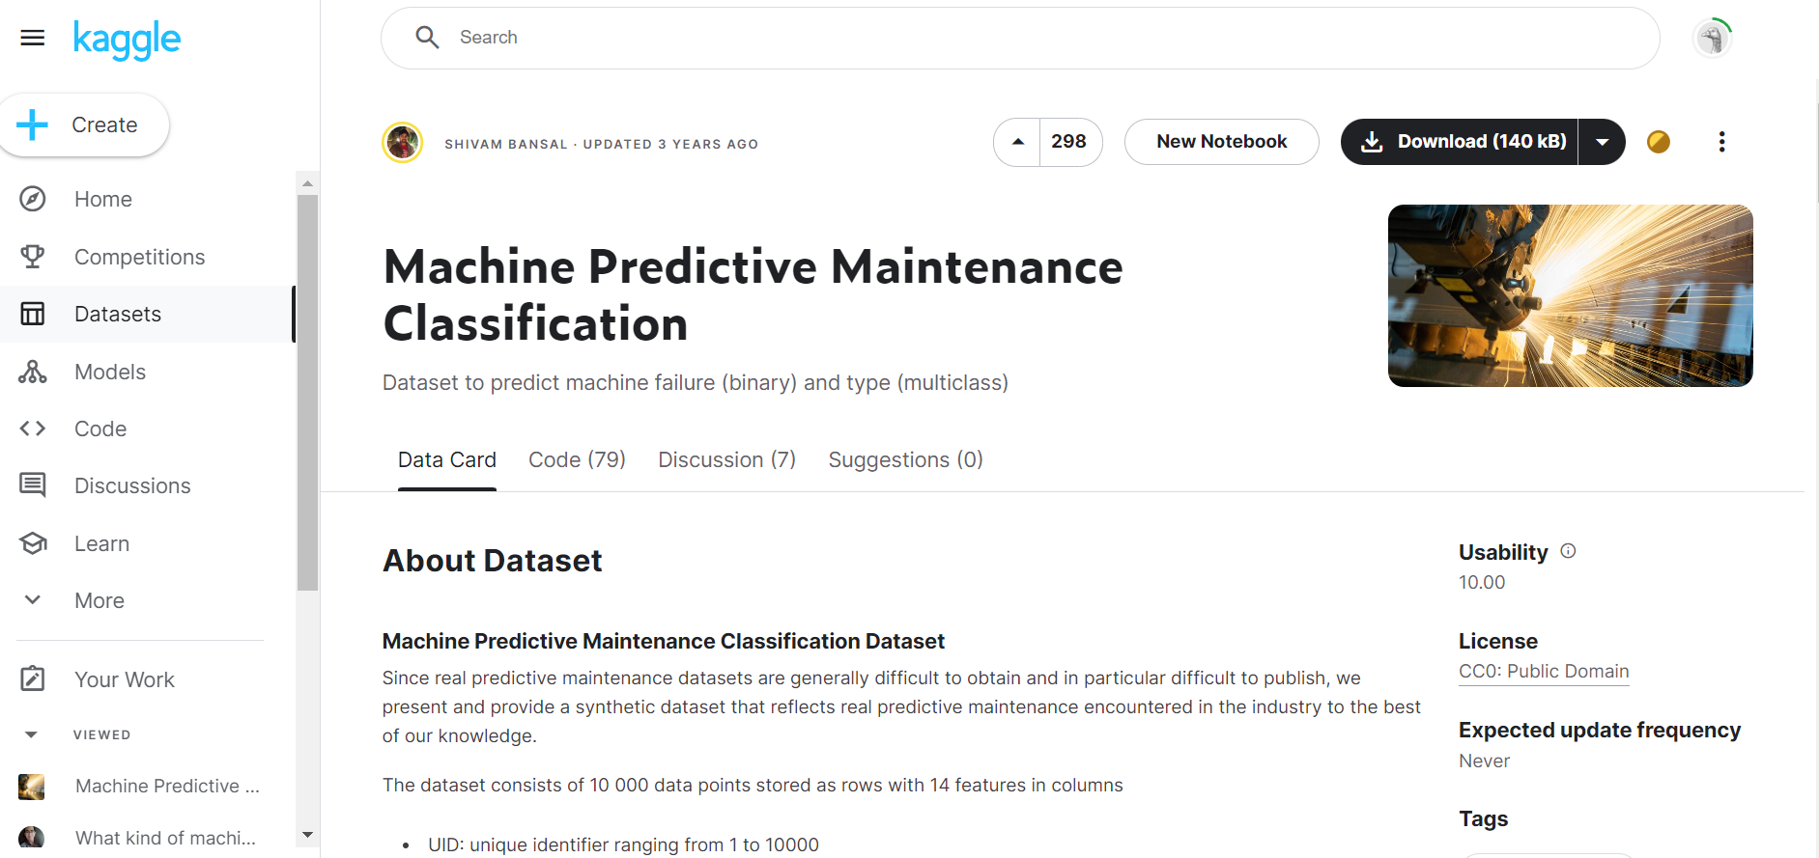
Dataset

Slide 15
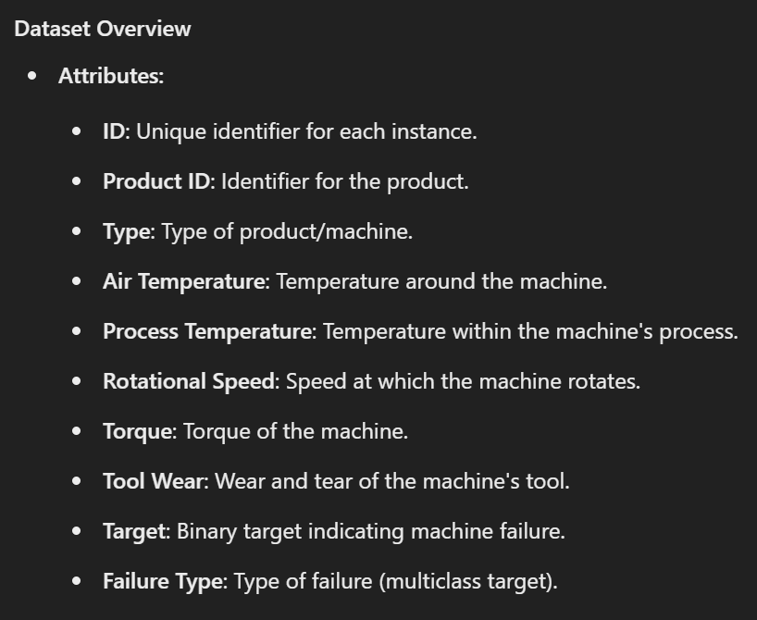

Slide 16
Thank You

